Slide 1
Animations

Slide 2
Animations
Videogame Animations VS Cinema Animations
Animation types in Videogames
Keyframe Animation
Tweening
Unity Animation Components
Animator Window & Animator Component
Animation Clips & Animation Controllers
Practice:
Animation by Keyframes
Animation by Tweening
Mecanim
Blend Trees
Ragdolls & Physics Animation
Procedural Animation and IK
Practice: Procedural Animation
Two of my favorite talks about animation in Videogames

Slide 3
Videogames vs Cinema
Aspect | Film/TV Animation | Video Game Animation
Camera Angles | Fixed and controlled by creators | Multiple angles based on player control
Animation Structure | Sequential, fixed storyline | Cyclical, dependent on player actions
Control & Interactivity | Viewer has no control, passive experience | Player-controlled, highly interactive
Polygon Budget | High, allowing for detailed and complex models | Lower, optimized for real-time rendering
Technical Limitations | Minimal, can use powerful hardware and software | Significant, must run smoothly on consoles and computers
Programming Knowledge | Not required | Required for creating interactive and responsive actions
Error Detection | Easier to catch mistakes during production | Harder to identify glitches due to numerous interactions
Rendering Process | Pre-rendered, can be extensively edited | Real-time rendering, must be optimized for performance

Slide 4
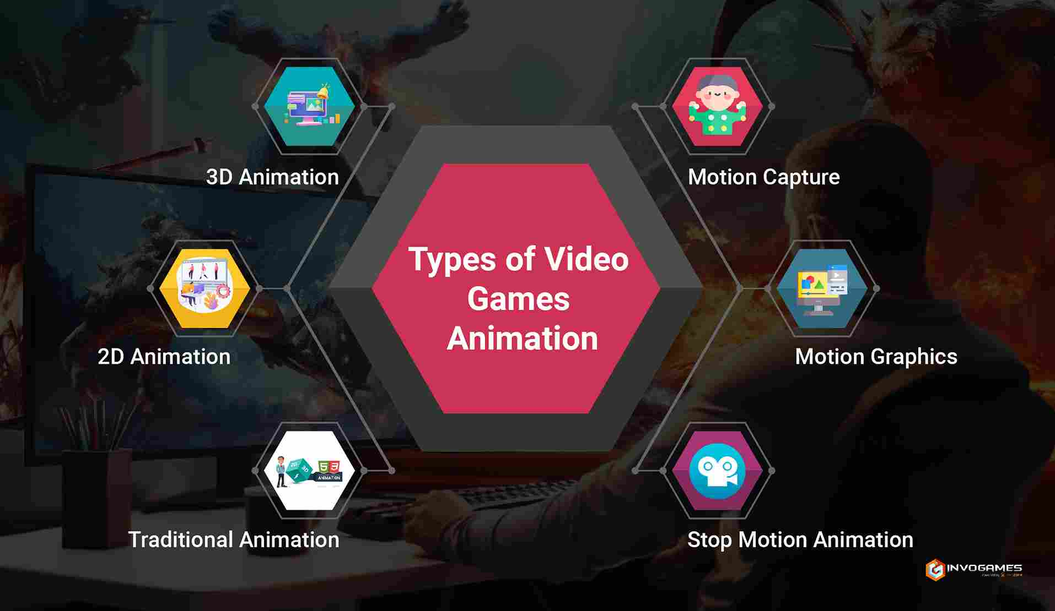
Animation Types in videogames

Slide 5
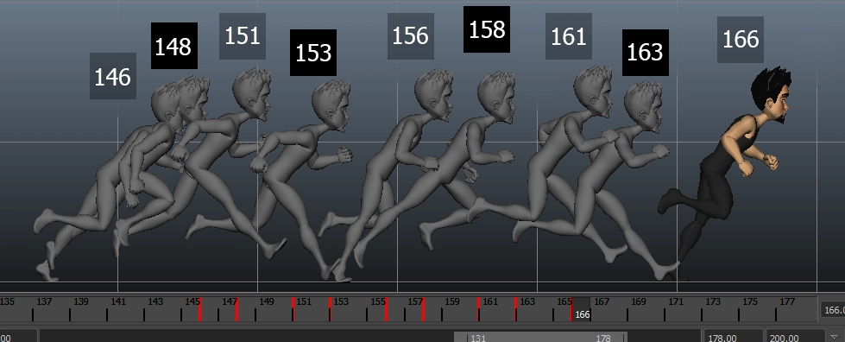
Animation Types in videogames: Keyframe

Slide 6
Animation Types in videogames: Keyframe

Slide 7

Animation Types in videogames: Tweening

Slide 8
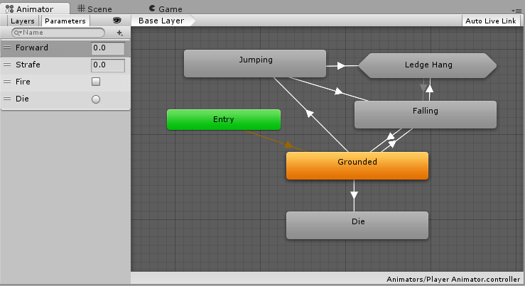
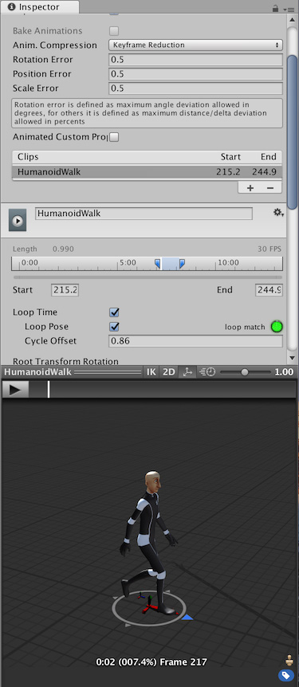
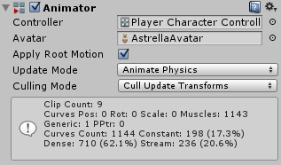
Unity Animation Components
Animation Clip
Animator Controller
Animator Component

Slide 9
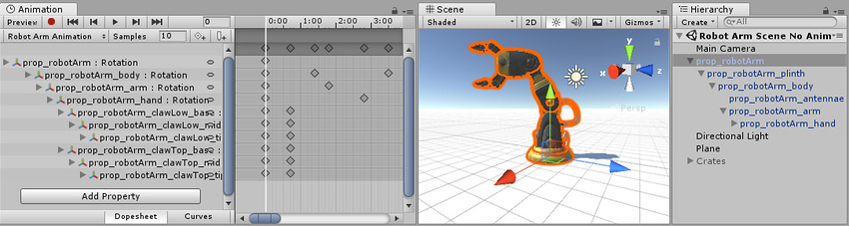
Unity Animation View

Slide 10
Practice: Let’s animate by KEYFRAMES

Slide 11
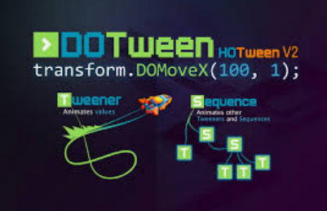
Practice: Let’s animate by TWEENING using DoTween

Slide 12
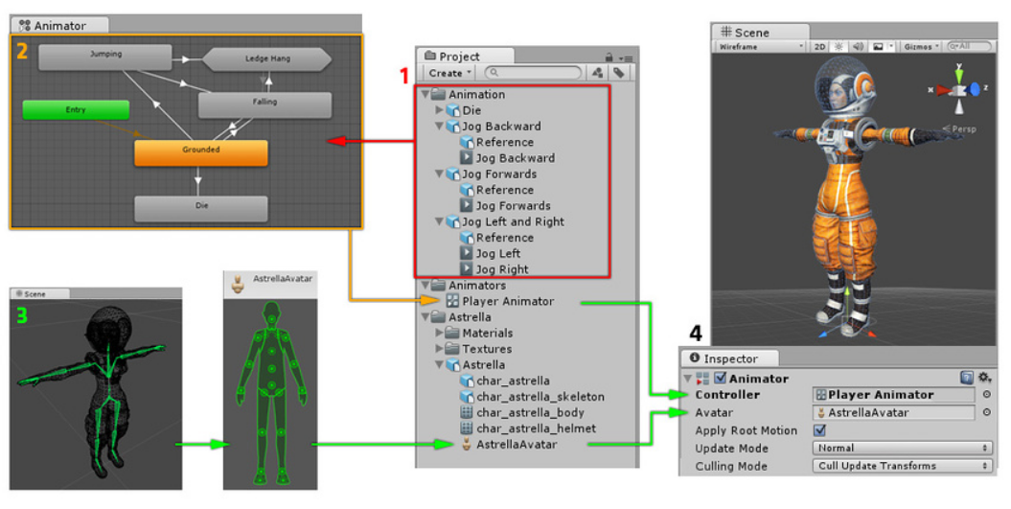
Unity Animation System (Mecanim)

Slide 13
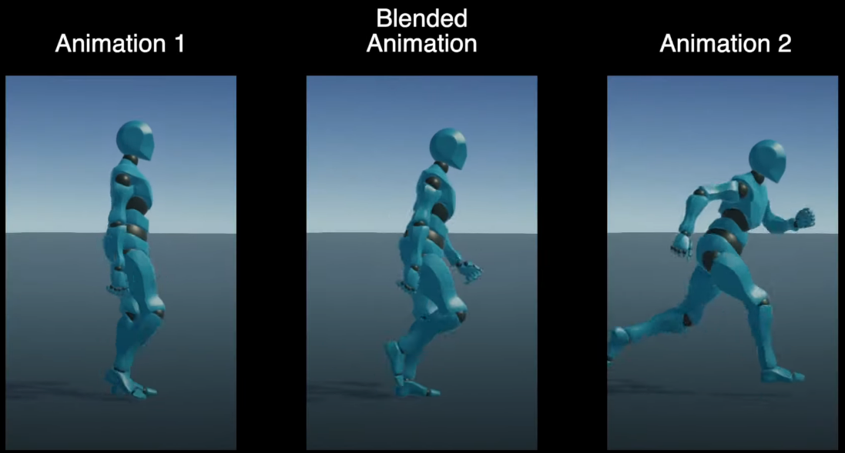
Blend Trees

Slide 14
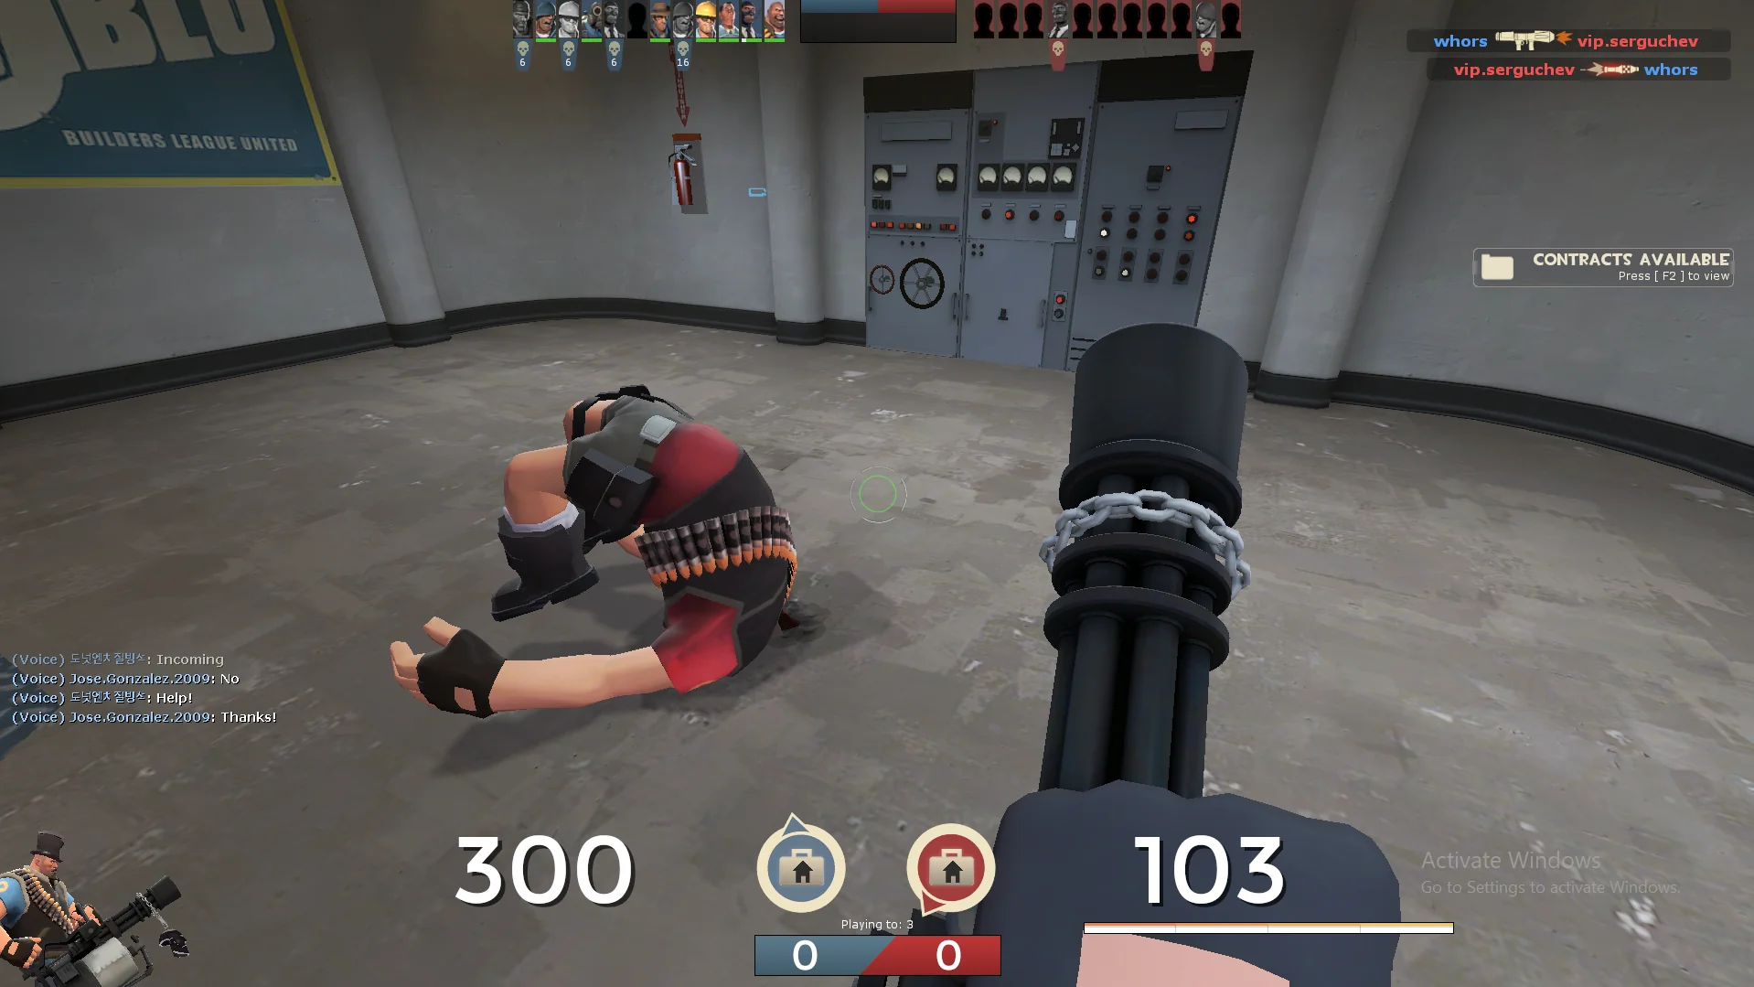
Ragdolls

Slide 15
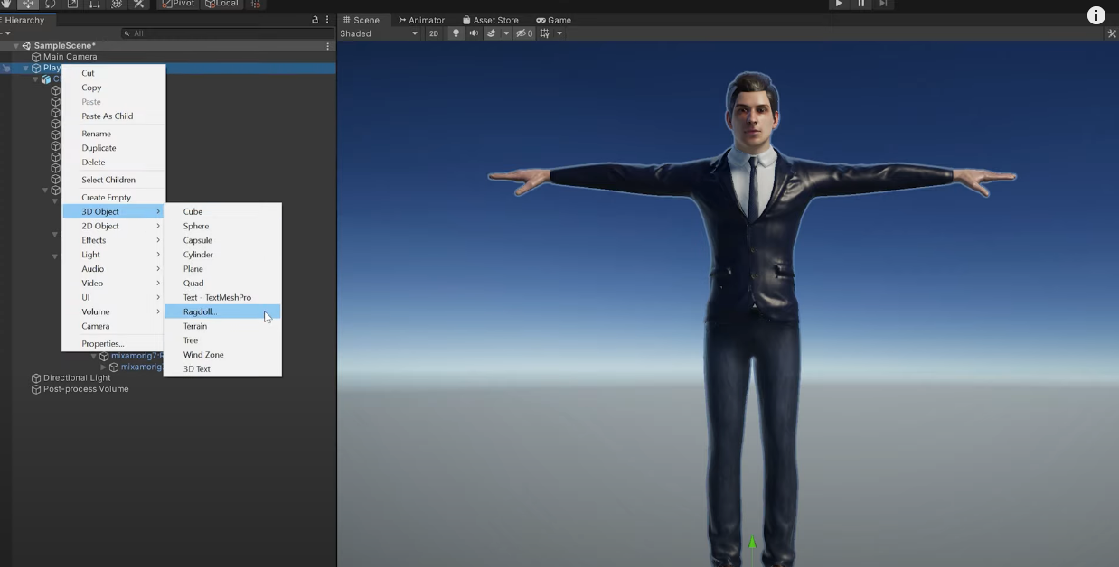
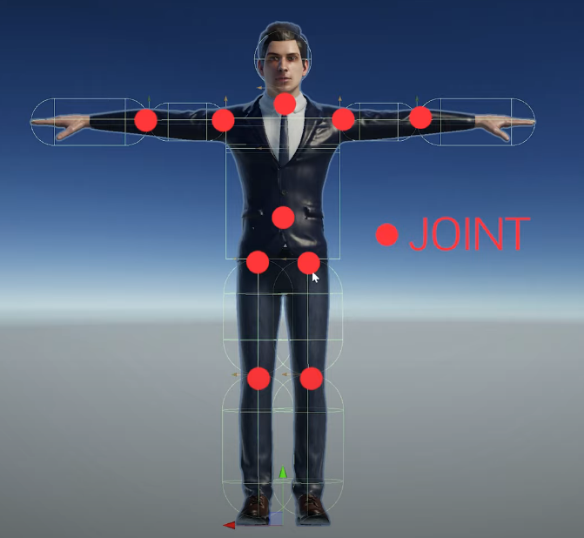
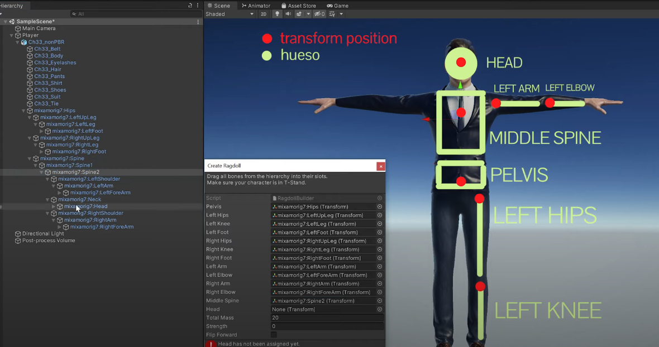
Ragdolls in Unity

Slide 16
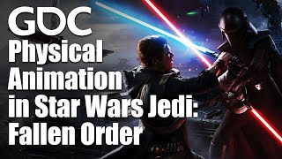
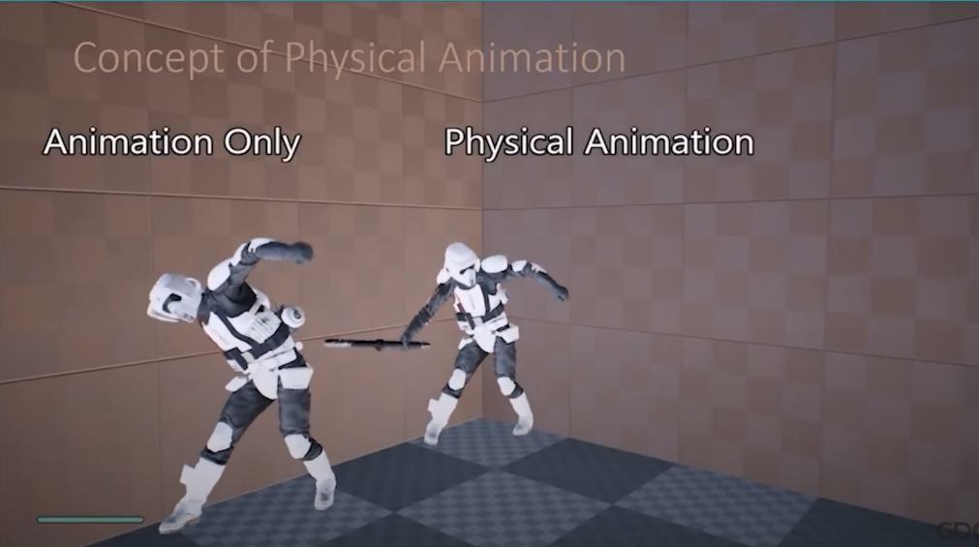
Physical Animation

Slide 17
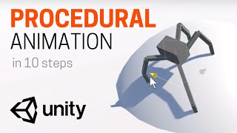
Procedural Animation and IK

Slide 18
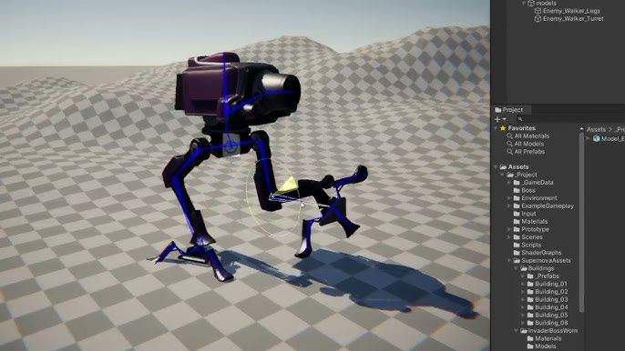
Practice: Let’s animate Procedurally

Slide 19
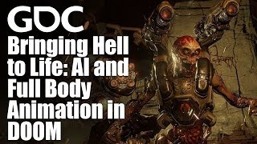
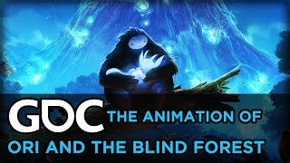
Two of my favorite talks about animation in Videogames

